Slide 1


Slide 2
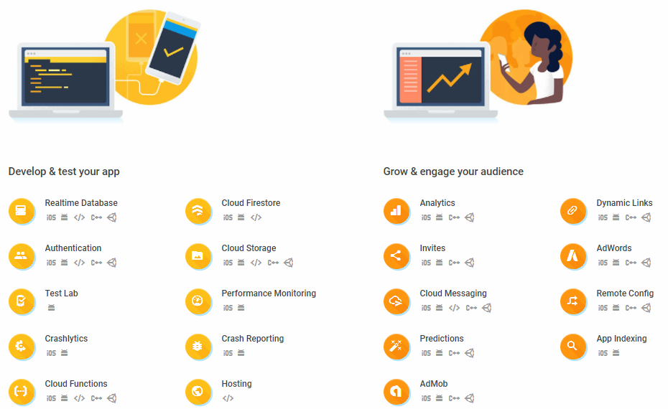

Slide 3


Slide 4

The Firebase Realtime Database is a cloud-hosted database.
Data is stored as JSON and synchronized in realtime to every connected client.
When you build cross-platform apps with our iOS, Android, and JavaScript SDKs, all of your clients share one Realtime Database instance and automatically receive updates with the newest data.

Slide 5
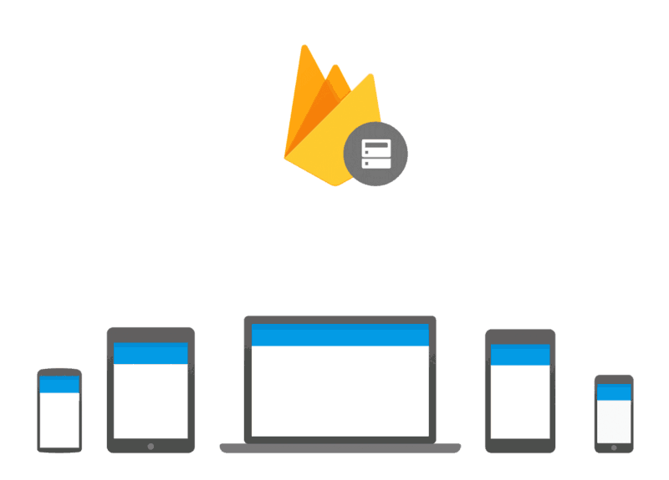

Slide 6

Collaborate across
devices with ease
Realtime syncing makes it easy for your users to access their data from any device: web or mobile, and it helps your users collaborate with one another.
Collaborate across devices with ease

Slide 7
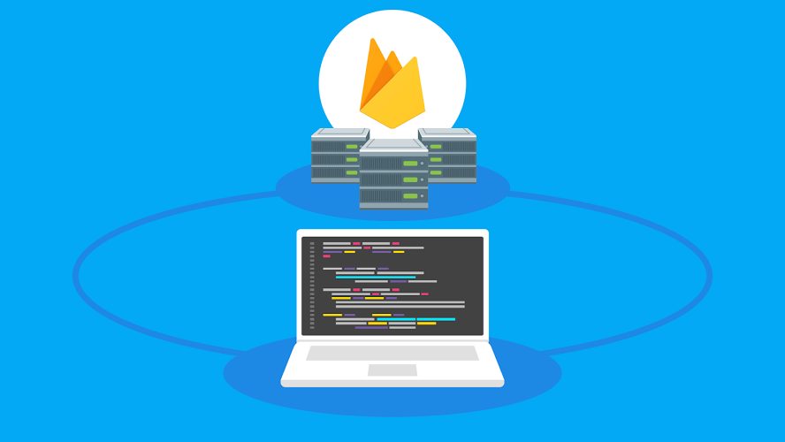
Build serverless apps
Realtime Database ships with mobile and web SDKs so you can build apps without the need of servers.

Slide 8

Optimized for offline use
When your users go offline, the Realtime Database SDKs use local cache on the device to serve and store changes. When the device comes online, the local data is automatically synchronized.

Slide 9
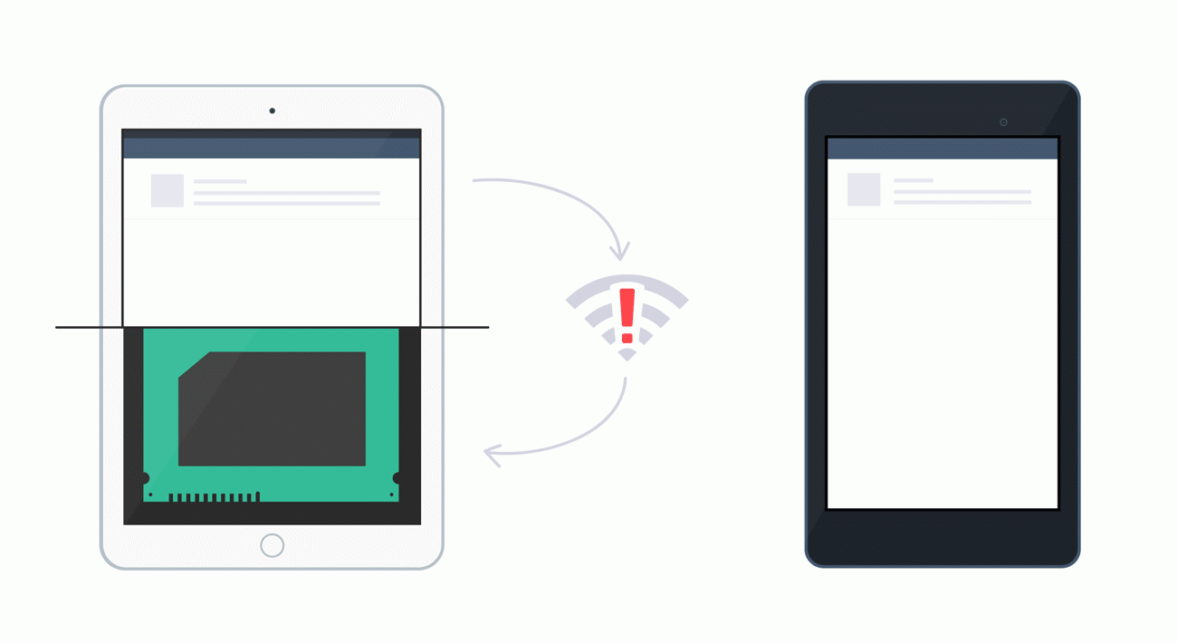

Slide 10

Strong user-based security
The Realtime Database integrates with Firebase Authentication to provide simple and intuitive authentication for developers.

Slide 11
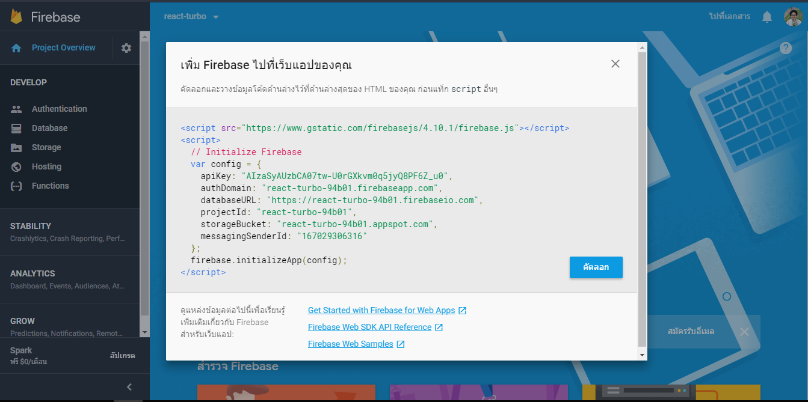
Configuration Firebase

Slide 12
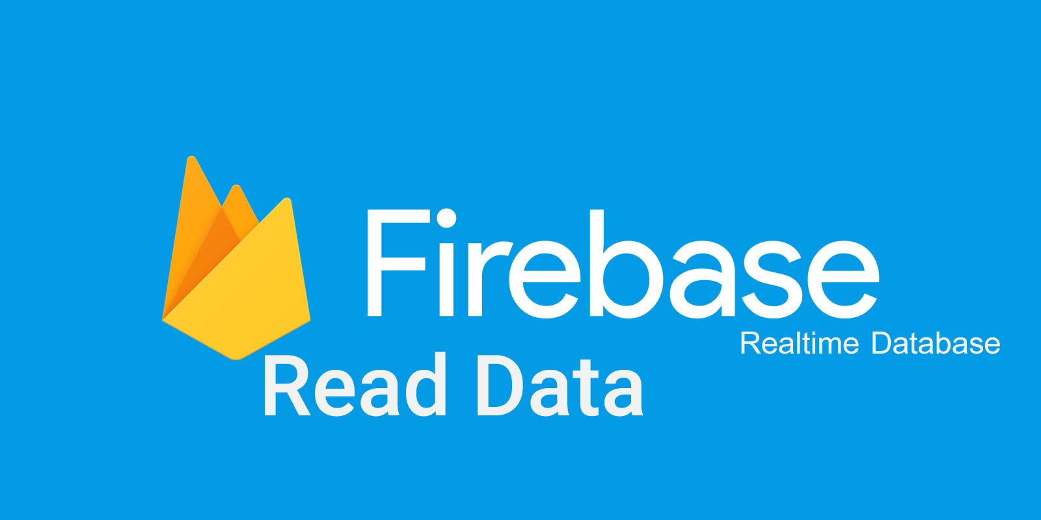

Slide 13
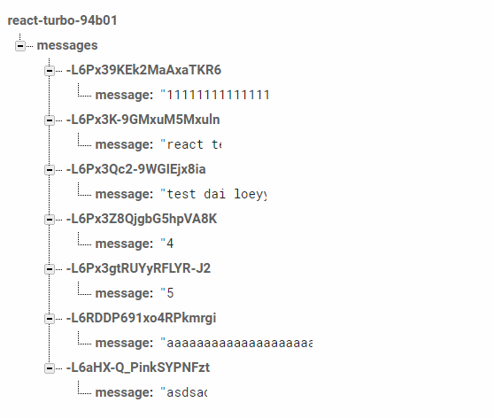

Example Read with React
let dbCon = firebase.database().ref('messages');
dbCon.on('value', snapshot => {
console.log(snapshot.val());
});

Slide 14
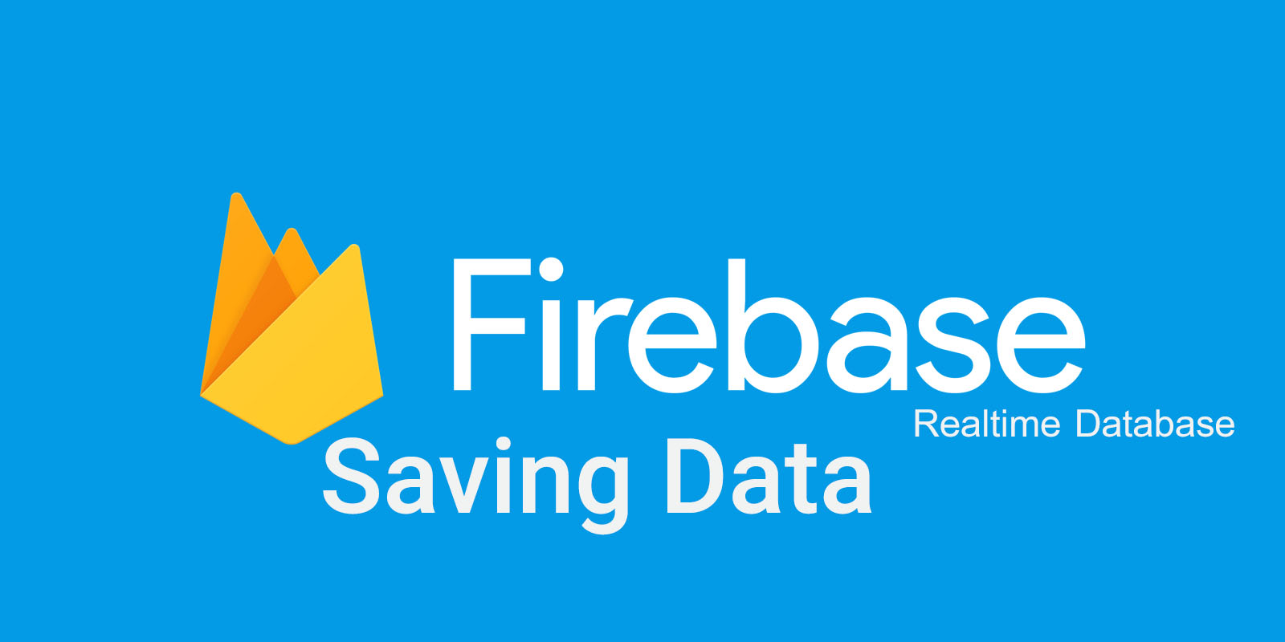

Slide 15
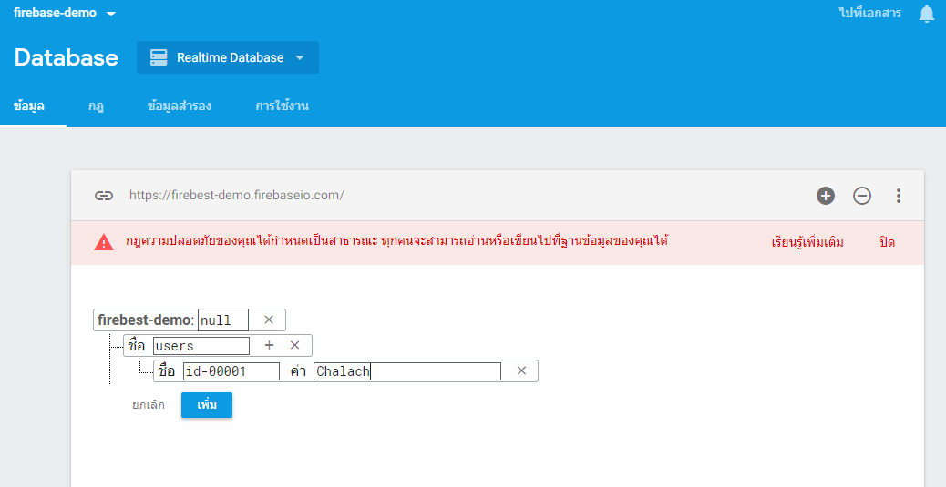
Manual Saving(Add/Insert/Create) Data

Slide 16
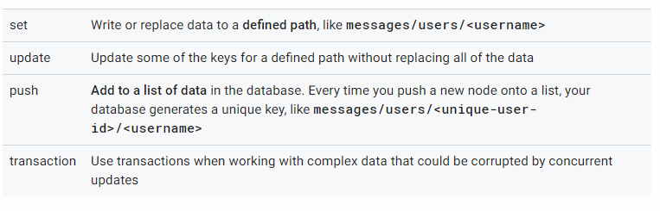
Way To Saving(Add/Insert/Create) Data [Coding]
This document covers the four methods for writing data to your Firebase Realtime Database: set, update, push, and transactions support.
4 Way To Saving

Slide 17



Example Saving with React
let dbCon = firebase.database().ref('/messages' + messageId);
let dbConNormal = firebase.database().ref('/messages');
dbCon.set({
message: xxx
});
dbConNormal.push({
message: xxx
});
var obj = {message: xxx};
dbConNormal.child(messageId).update(obj);

Slide 18


Slide 19
Example Update with React
let dbCon = firebase.database().ref('/messages');
var obj = {message: xxx};
dbCon.child(messageId).update(obj);

Slide 20
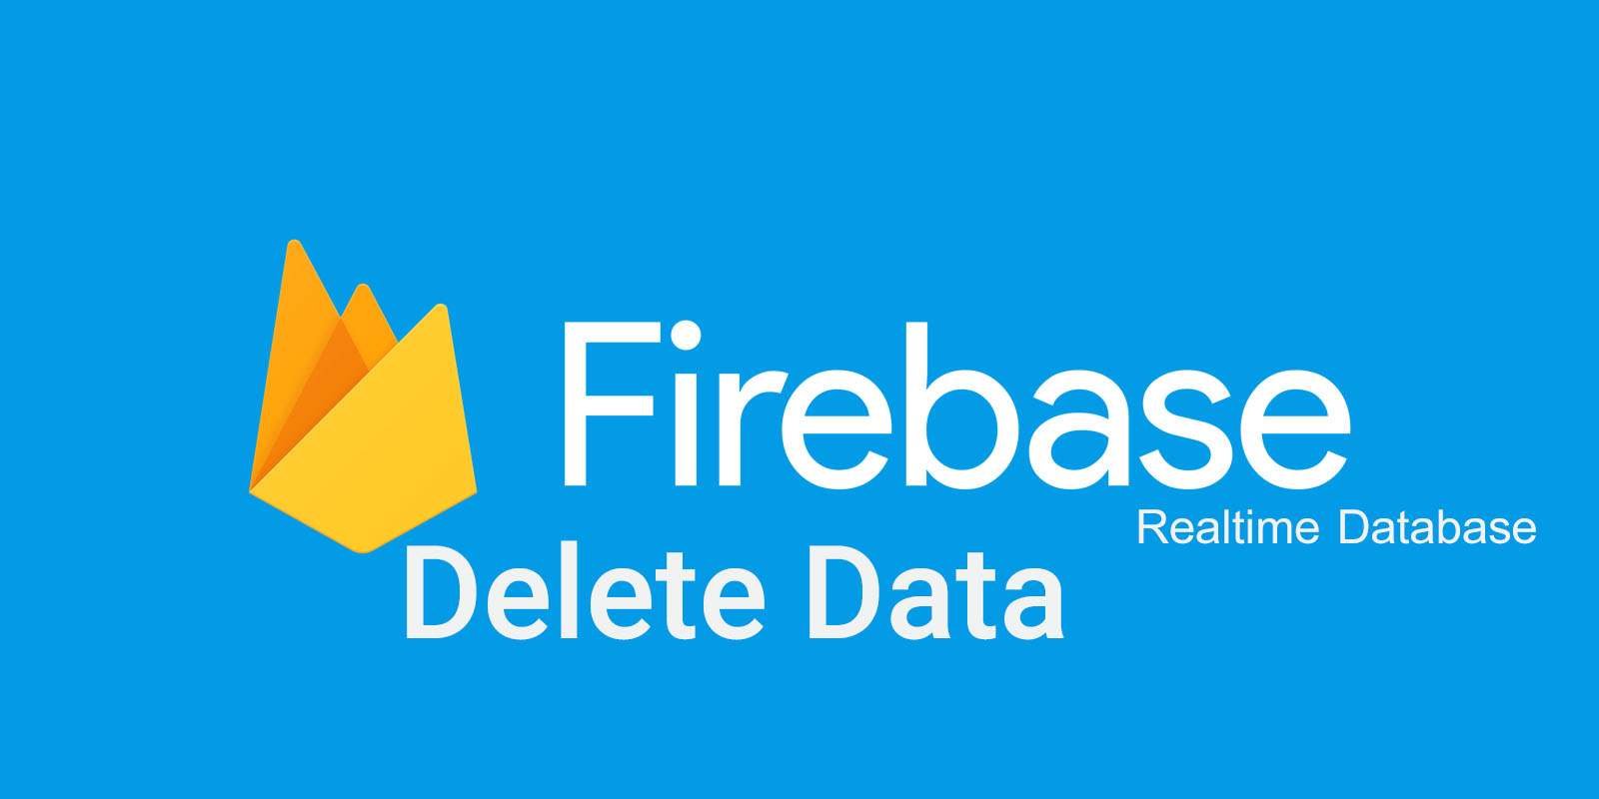

Slide 21
Example Delete with React
let dbCon = firebase.database().ref('/messages');
dbCon.child(messageId).remove();

Slide 22
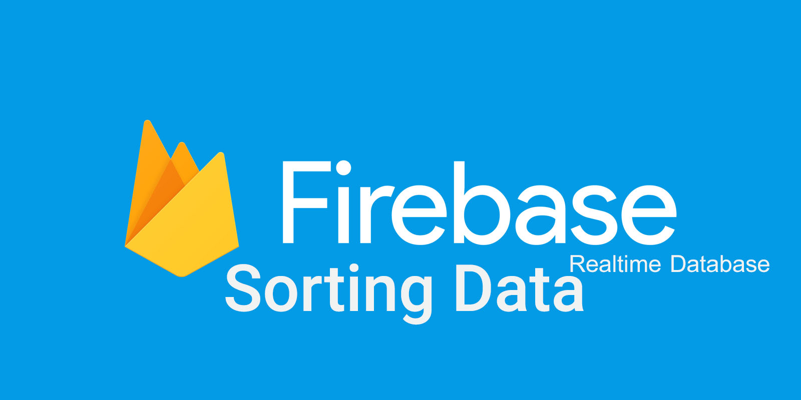

Slide 23
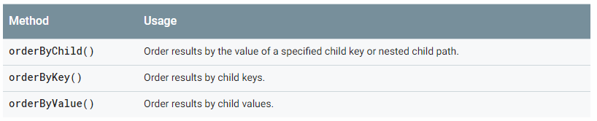
Sort Data
You can use the Realtime Database Query class to retrieve data sorted by key, by value, or by value of a child. You can also filter the sorted result to a specific number of results or a range of keys or values.
let dbCon = firebased.database().ref('messages' + messageId).orderByChild('xxx');
let dbCon = firebased.database().ref('messages' + messageId).orderByKey();
let dbCon = firebased.database().ref('messages' + messageId).orderByValue();

Slide 24
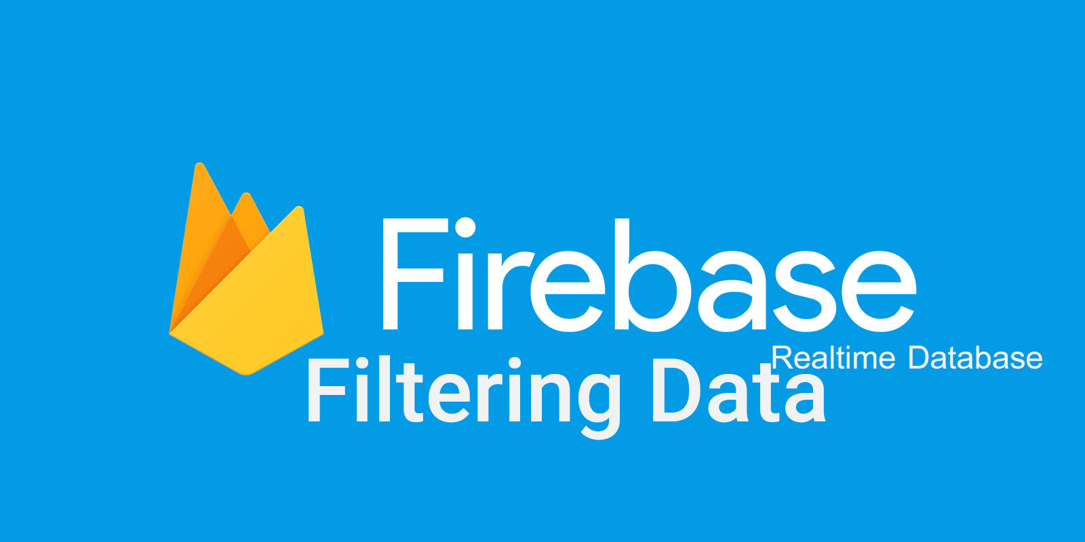

Slide 25
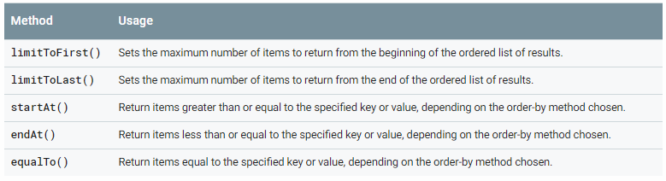
Filter Data
To filter data, you can combine any of the limit or range methods with an order-by method when constructing a query.

Slide 26
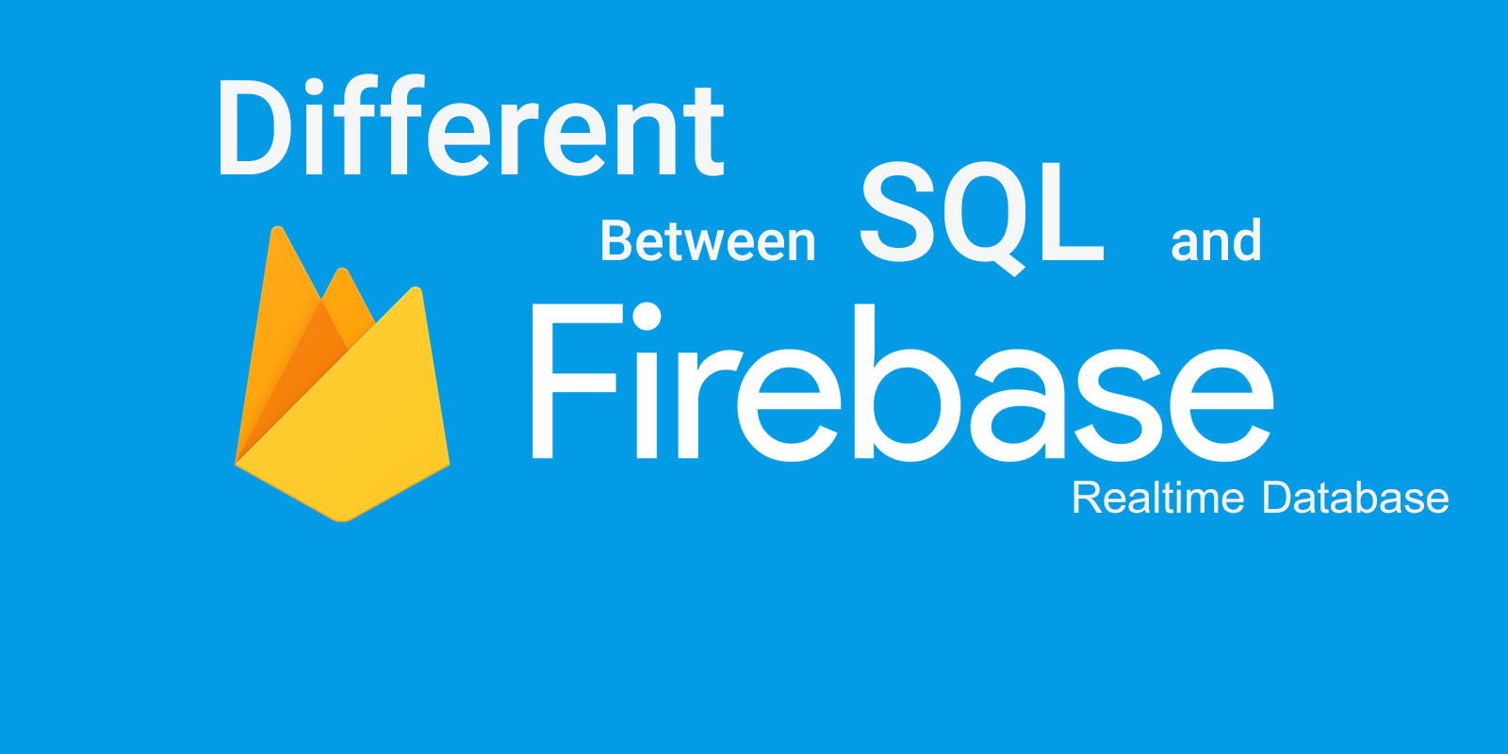

Slide 27
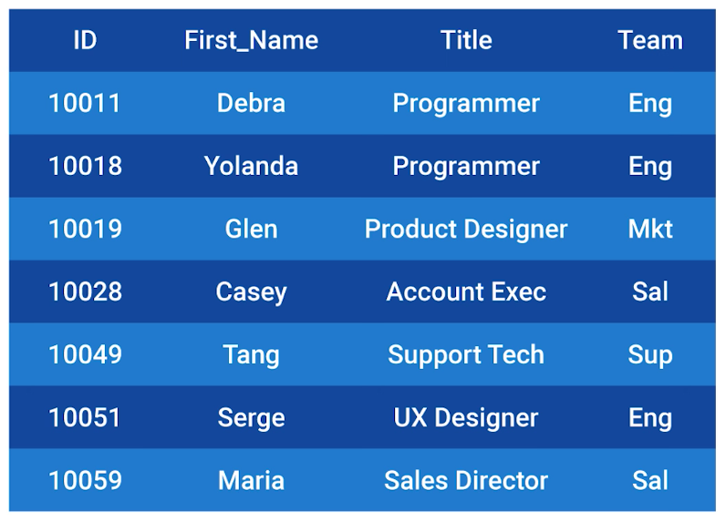
SQL Database (Relational Database)

Slide 28
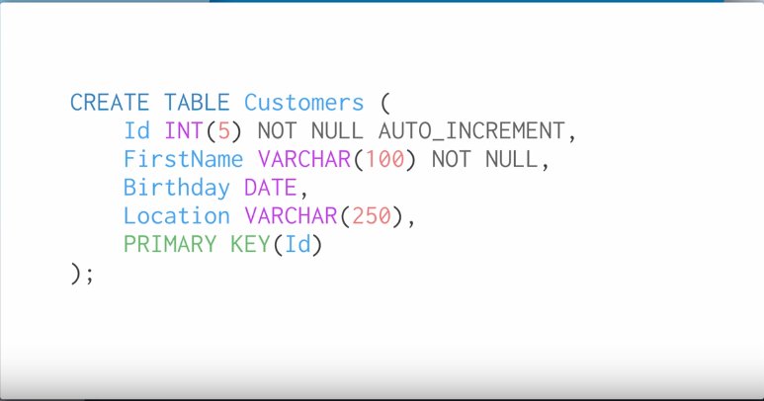
Create Table

Slide 29
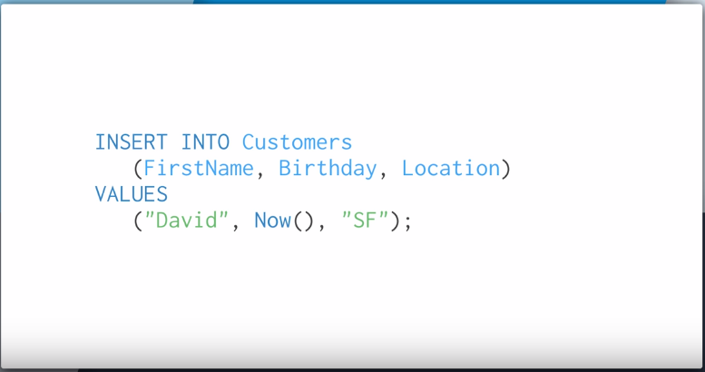
Insert Data

Slide 30
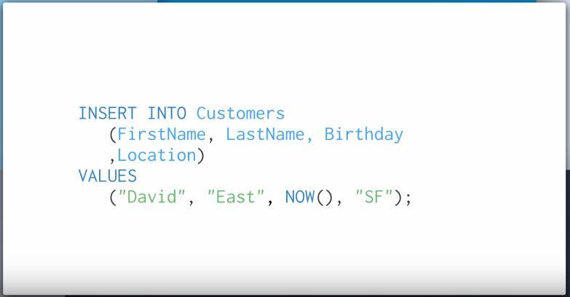

Insert Data(2)

Slide 31
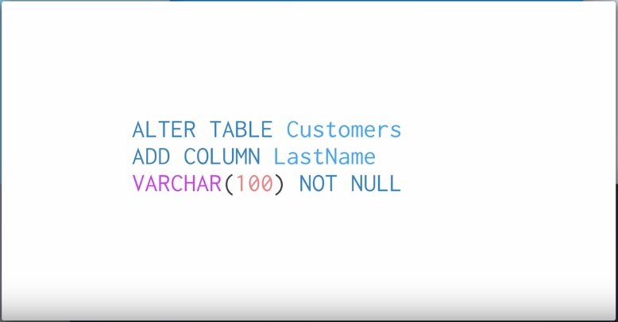
Alter Table

Slide 32
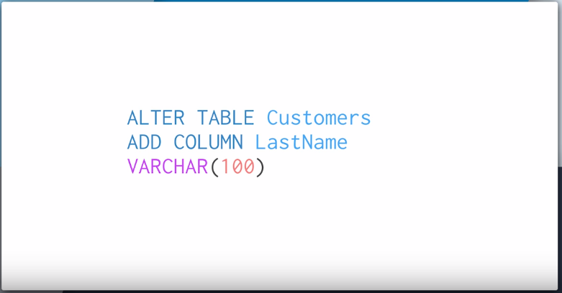
Alter Table

Slide 33
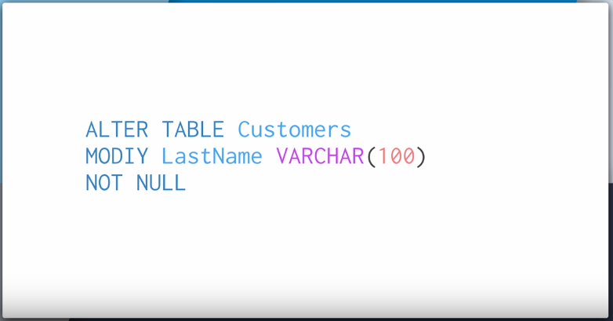
Alter Table

Slide 34
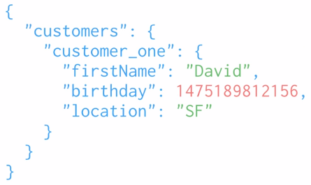
Firebase Database (NoSQL Database)
customers.child("customer_one").child("lastname").setValue("New Lastname")

Slide 35
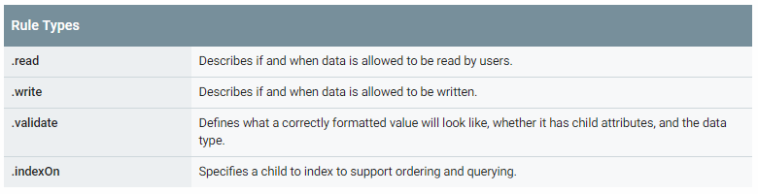
Understand Firebase Realtime Database Rules
Firebase Realtime Database Rules determine who has read and write access to your database, how your data is structured, and what indexes exist. These rules live on the Firebase servers and are enforced automatically at all times. Every read and write request will only be completed if your rules allow it. By default, your rules are set to allow only authenticated users full read and write access to your database. This is to protect your database from abuse until you have time to customize your rules or set up authentication.
Firebase Database Rules have a JavaScript-like syntax and come in four types:

Slide 36
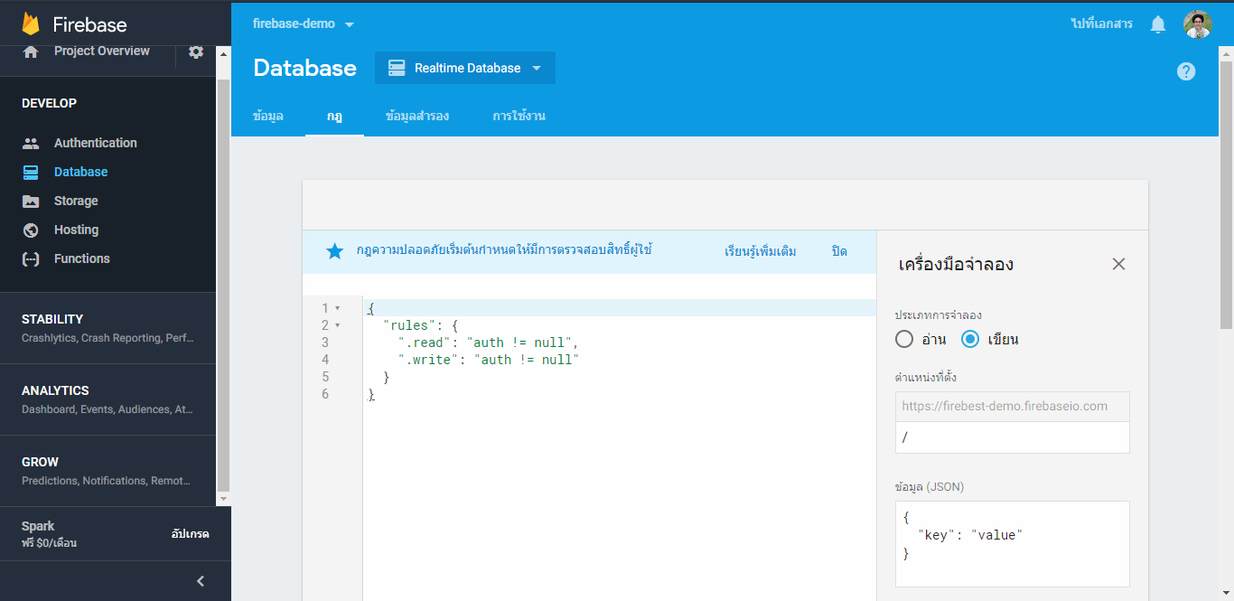
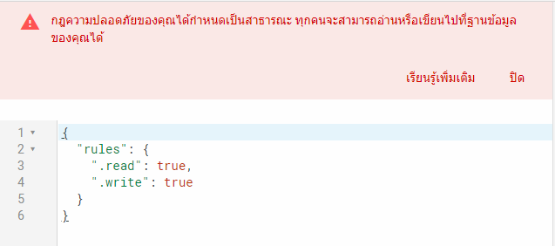

Rules .read .write

Slide 37
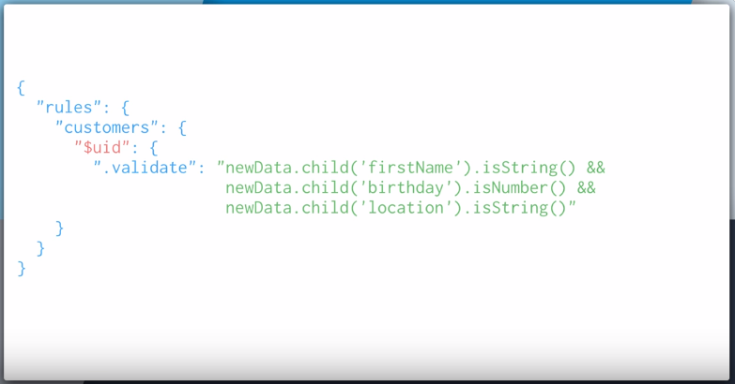
Rules .validate

Slide 38
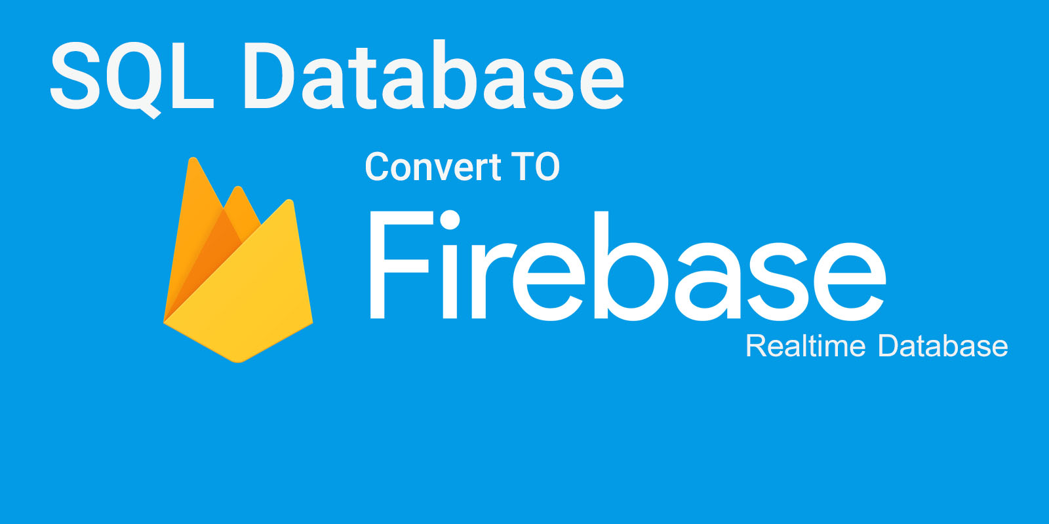

Slide 39
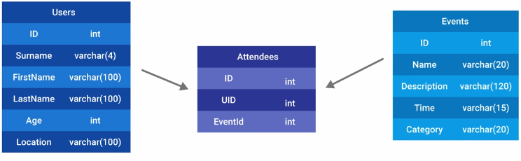
SQL Structure Example

Slide 40
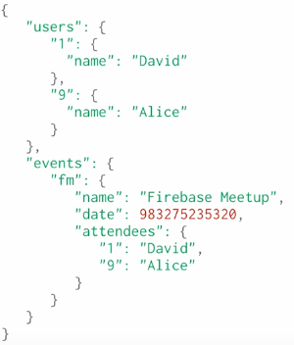
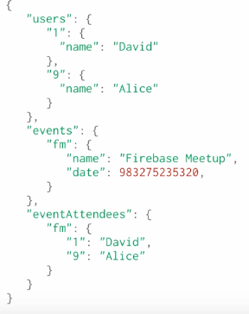
NoSQL Structure Example

Slide 41
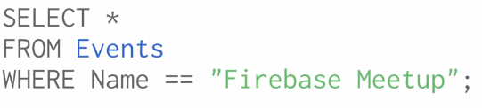
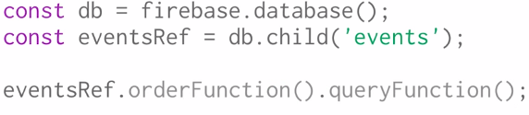
SELECT

Slide 42
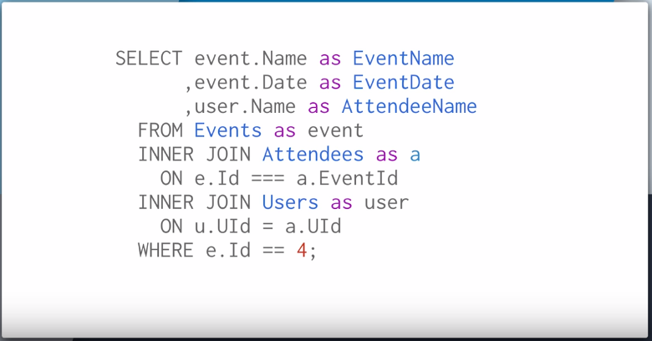
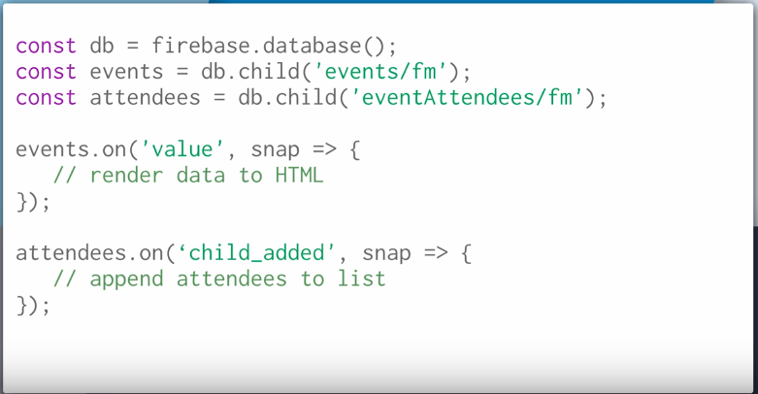
SELECT (2)

Slide 43
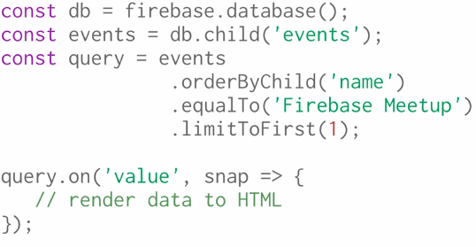
SELECT (3)

Slide 44
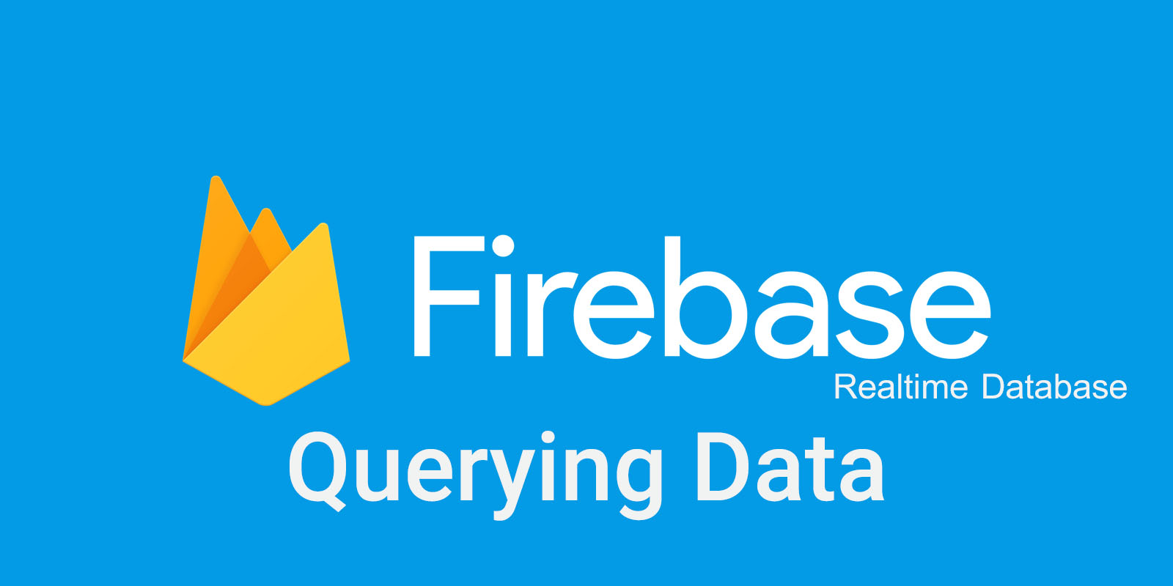

Slide 45
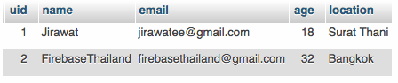
SQL Database
Firebase Database
{
"users" : {
"1" : {
"age" : 18,
"email" : "jirawatee@gmail.com",
"location" : "SuratThani",
"name" : "Jirawat"
},
"2" : {
"age" : 32,
"email" : "firebasethailand@gmail.com",
"location" : "Bangkok",
"name" : "FirebaseThailand"
}
}
}

Slide 46
SQL Query
# 1. Select a user by UID
# 2. Find a user by email address
# 3. Limit to 10 users
# 4. Get all users names that start with 'F'
# 5. Get all users who are age less than 25
# 6. Get all users who are age greater than 25
# 7. Get all users who are age between 18 and 32
# 8. Get all users who are 32 and live in Bangkok
SELECT * FROM Users WHERE uid = 1
SELECT * FROM users WHERE email = 'firebasethailand@gmail.com'
SELECT * FROM users LIMIT 10
SELECT * FROM users WHERE name LIKE 'F%'
SELECT * FROM user WHERE age < 25
SELECT * FROM users WHERE age >= 25;
SELECT * FROM users WHERE age >= 18 && age <= 32;
SELECT * FROM users WHERE age = 32 && Location = 'Bangkok';

Slide 47
Firebase Query
const mRootRef = firebase.database().ref('...');
# 1. Select a user by UID
# 2. Find a user by email address
# 3. Limit to 10 users
# 4. Get all users names that start with 'F'
# 5. Get all users who are age less than 25
# 6. Get all users who are age greater than 25
# 7. Get all users who are age between 18 and 32
# 8. Get all users who are 32 and live in Bangkok
mRootRef.child(“users”).child(“1”);
mRootRef.child(“users”).orderByChild(‘email’).equalTo(“firebasethailand@gmail.com”);
mRootRef.child(“users”).orderByKey().limitToFirst(10);
mRootRef.child(“users”).orderByChild(“name”).startAt(“F”);
mRootRef.child(“users”).orderByChild("age").endAt(25);
mRootRef.child(“users”).orderByChild("age").startAt(25);
mRootRef.child(“users”).orderByChild("age").startAt(18).endAt(32);
mRootRef.child(“users”).orderByChild("age").equalTo(32) .orderByChild("location").equalTo("Bangkok");

Slide 48
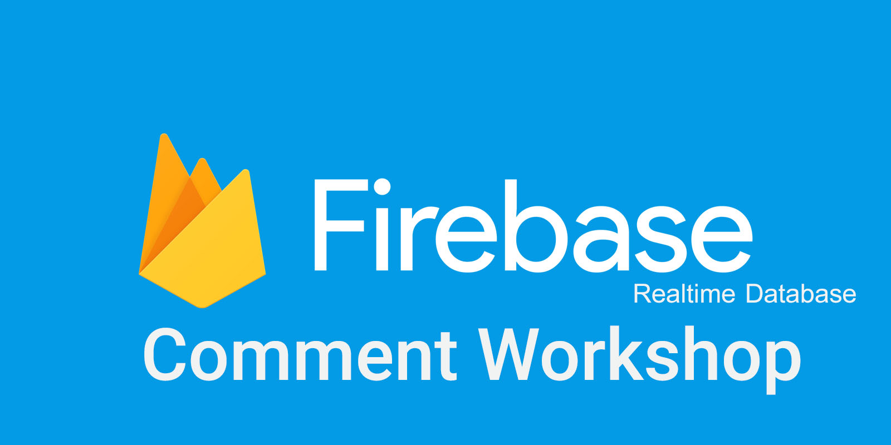

Slide 49

Homework
-

Slide 50
Reference
https://firebase.google.com/docs
https://developers.ascendcorp.com/รู้จัก-firebase-realtime-database-ตั้งแต่-zero-จนเป็น-hero-5d09210e6fd6ฃ
https://developers.ascendcorp.com/มาทำความเข้าใจกับ-sql-database-และ-firebase-database-กันเถอะ-4aed4a19e339
https://appdividend.com/2017/07/22/react-firebase-tutorial/
React: Functional Web Development with React and Redux 1st Edition, Kindle Edition

